Slide 1
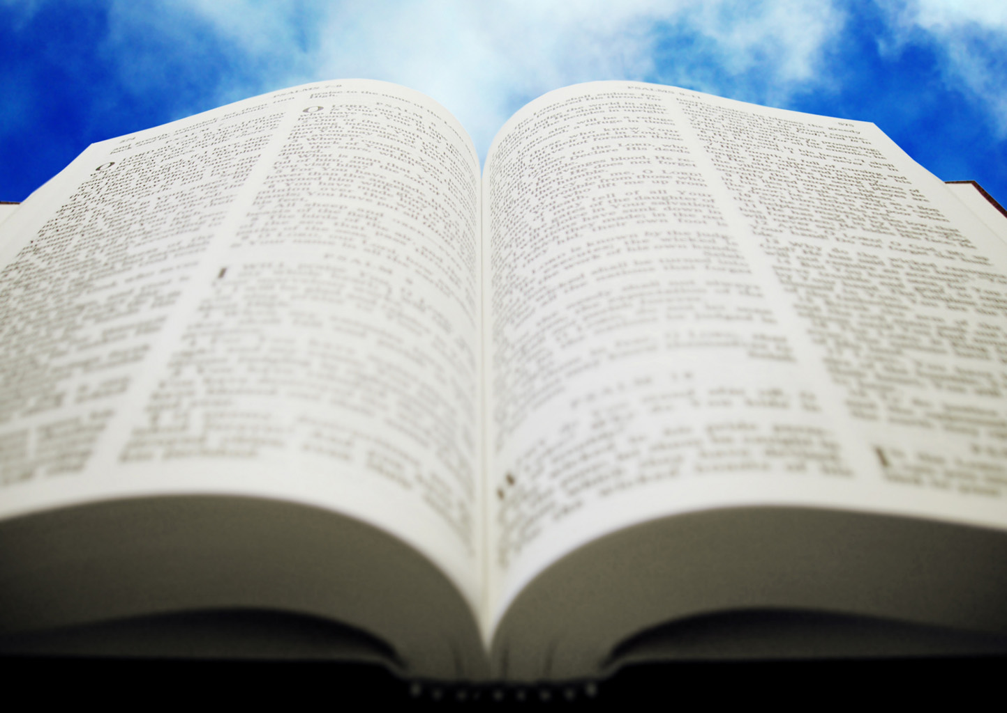
Welcome!
Sunday
Worship 10:00 AM
Sunday
Bible Class (Livestream) 5:00 PM
Wednesday
Bible Class 7:00 PM
www.SunsetchurchofChrist.net

Slide 2
Opening Prayer
Song – | Craig Foster
Song – | Craig Foster
Lord’s Supper
Song – | Craig Foster
Song – | Craig Foster
Lesson | Brian Haines
Song – | Craig Foster
Closing
1 Corinthians 16:2
On the first day of the week let each one of you lay something aside, storing up as he may prosper, that there be no collections when I come.
A collection basket
is in the foyer

Slide 3
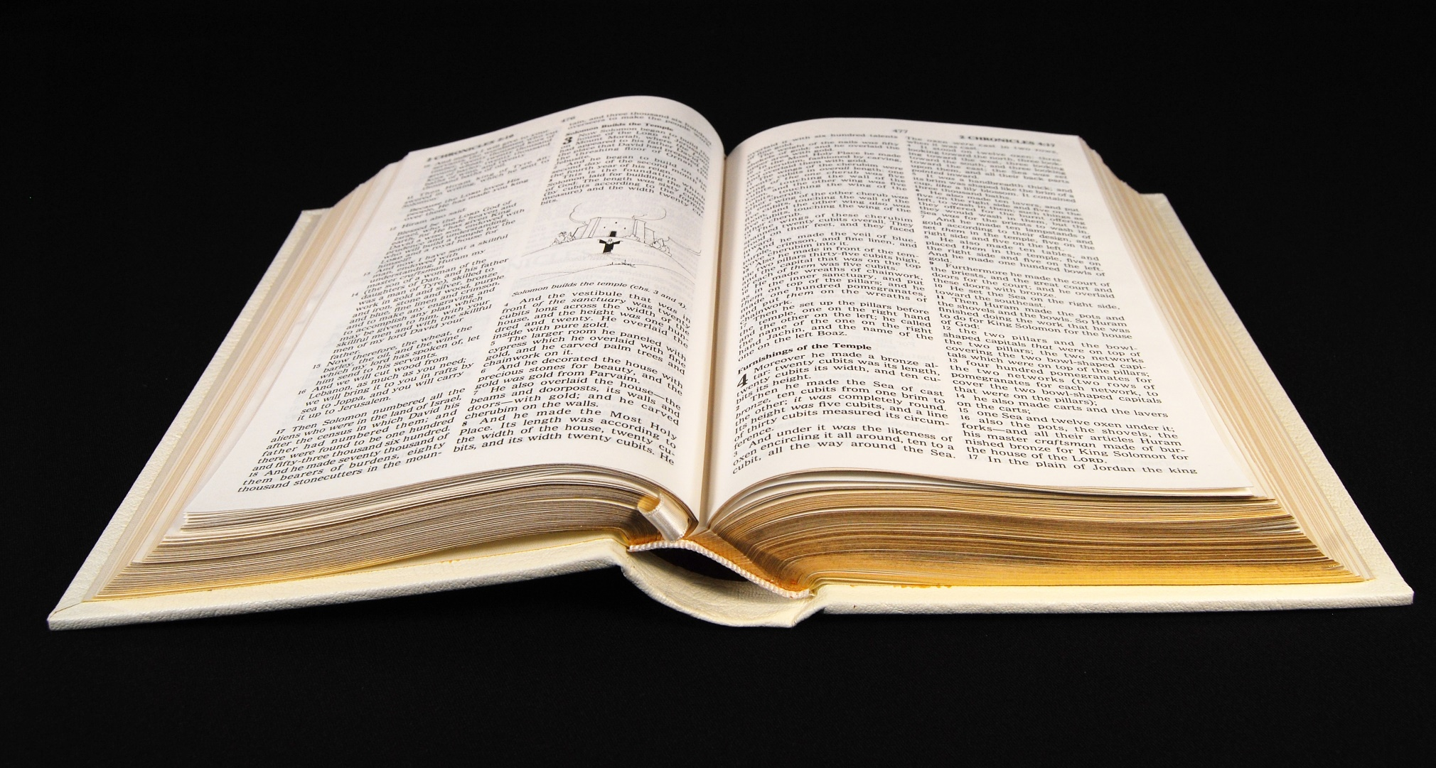
Discerning the Body 1 Corinthians 11:23-34

Slide 4
Paul’s Directive
But let a man examine himself, and so let him eat of the bread and drink of the cup. For he who eats and drinks in an unworthy manner eats and drinks judgment to himself, not discerning the Lord's body. 1 Corinthians 11:28-29

Slide 5
Context
The cup of blessing which we bless, is it not the communion of the blood of Christ? The bread which we break, is it not the communion of the body of Christ? For we, though many, are one bread and one body; for we all partake of that one bread. 1 Corinthians 10:16-17

Slide 6
Context
Paul stressed unity by doctrinal accord
The cup of the Lord vs. the cup of demons
Godliness vs. idolatry
In this image:
The church is the bread

Slide 7
Context
Paul stressed unity by doctrinal accord
The dilemma: disunited at communion
Not waiting for each other
Not partaking in the right mind

Slide 8
Communion
“Communion of the blood of Christ”
“What communion has light with darkness”
“The communion of the Holy Spirit”
Notes:
1Co 10:16 The cup of blessing which we bless, is it not the communion of the blood of Christ? The bread which we break, is it not the communion of the body of Christ?
2Co 6:14 Do not be unequally yoked together with unbelievers. For what fellowship has righteousness with lawlessness? And what communion has light with darkness?
2Co 13:14 The grace of the Lord Jesus Christ, and the love of God, and the communion of the Holy Spirit be with you all. Amen.

Slide 9
Communion
Communion = Common union
United by what we have in common
The Blood of Christ = covenant
The Body of Christ = the church
Notes:
1Co 10:16 The cup of blessing which we bless, is it not the communion of the blood of Christ? The bread which we break, is it not the communion of the body of Christ?
2Co 6:14 Do not be unequally yoked together with unbelievers. For what fellowship has righteousness with lawlessness? And what communion has light with darkness?
2Co 13:14 The grace of the Lord Jesus Christ, and the love of God, and the communion of the Holy Spirit be with you all. Amen.

Slide 10
Discernment
Discern – to understand, to see, rightly divide
Discern the body – understand the church
How do we “understand” the church?

Slide 11
Discernment
The church is the Body of Christ
Ephesians 5:23
Colossians 1:18
Notes:
Eph 5:23 For the husband is head of the wife, as also Christ is head of the church; and He is the Savior of the body.
Col 1:18 And He is the head of the body, the church, who is the beginning, the firstborn from the dead, that in all things He may have the preeminence.

Slide 12
Discernment
The church is the Body of Christ
The church is the collection of those saved
1 Corinthians 1:2
1 Timothy 3:15
Notes:
1Co 1:2 To the church of God which is at Corinth, to those who are sanctified in Christ Jesus, called to be saints, with all who in every place call on the name of Jesus Christ our Lord, both theirs and ours:
1Ti 3:15 but if I am delayed, I write so that you may know how you ought to conduct yourself in the house of God, which is the church of the living God, the pillar and ground of the truth.

Slide 13
Discernment
The church is the Body of Christ
The church is the collection of those saved
The church is the manifested kingdom
Hebrews 12:22-28
Colossians 1:13
Notes:
Heb 12:22 But you have come to Mount Zion and to the city of the living God, the heavenly Jerusalem, to an innumerable company of angels, 23 to the general assembly and church of the firstborn who are registered in heaven, to God the Judge of all, to the spirits of just men made perfect, Heb 12:28 Therefore, since we are receiving a kingdom which cannot be shaken
Col 1:13 He has delivered us from the power of darkness and conveyed us into the kingdom of the Son of His love,

Slide 14
Discernment
The church is the Body of Christ
The church is the collection of those saved
The church is the manifested kingdom
The church is the Temple of God
1 Corinthians 3:16
2 Corinthians 6:16
Notes:
2Co 6:16 And what agreement has the temple of God with idols? For you are the temple of the living God. As God has said: "I will dwell in them And walk among them. I will be their God, And they shall be My people."

Slide 15
Discernment
The church is the Body of Christ
The church is the collection of those saved
The church is the manifested kingdom
The church is the Temple of God
The church IS Christ!

Slide 16
Practical Applications
We need to be thinking of one another
Those who are going to heaven
We need to be present with one another
A visible assembly
We need to understand that this is Christ
Forsaking the church = forsaking Christ

Slide 18
Finding Salvation

